Slide 1
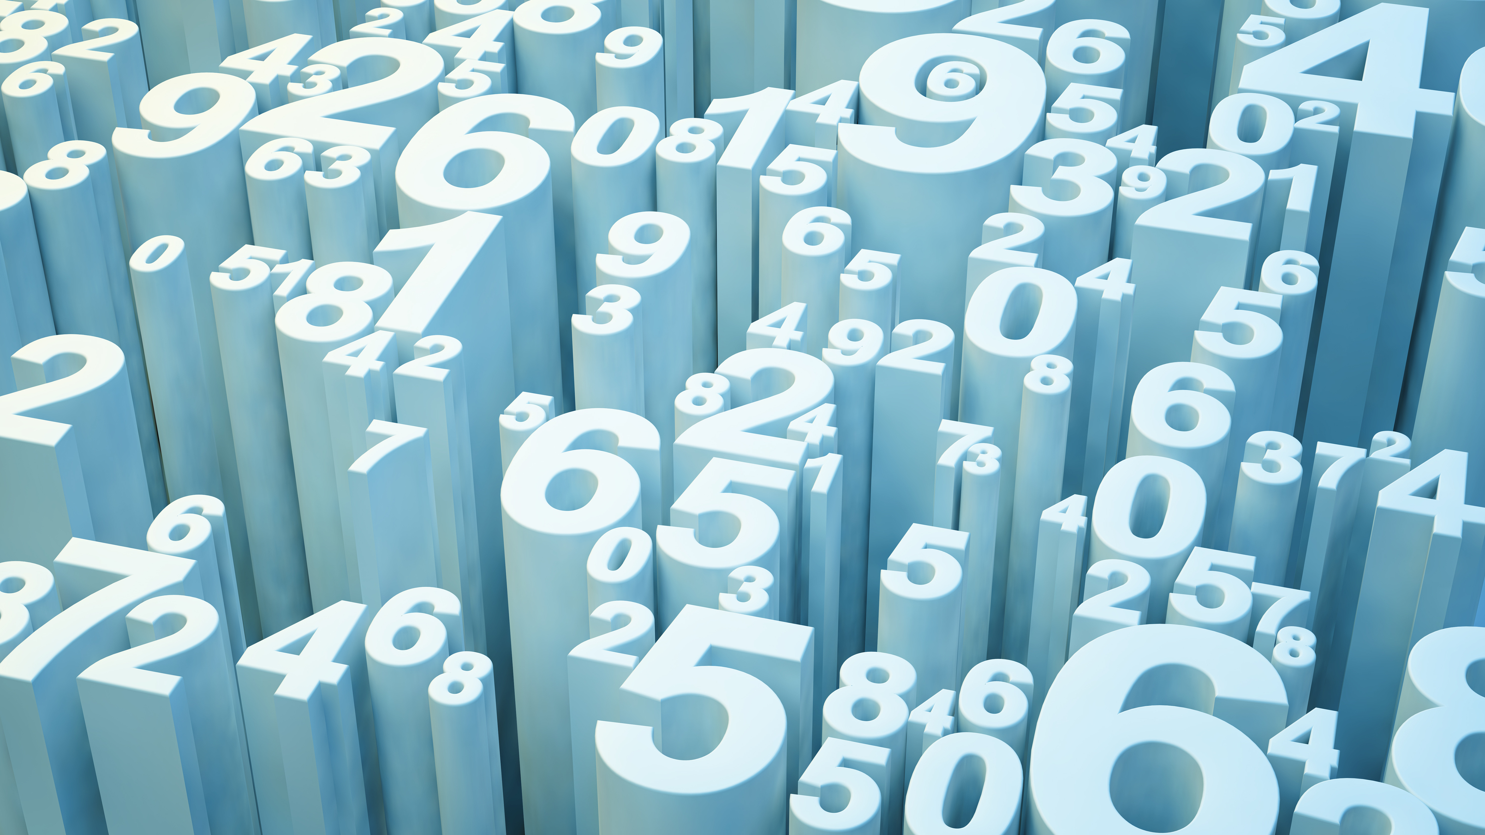

Predicting Disney Stock Price
David Berberena

Slide 2
Background
Disney Brothers Cartoon Studio was founded by Walt and Roy Disney in 1923.
The year 1957 was when Walt Disney Productions (as the Company was known at that time) went public with an IPO of $13.88 on the stock market.
Many current and potential investors are interested in either growing or maintaining their wealth within the Company’s stock.

Slide 3
The Business Need
Shareholders are most concerned with the longevity of their return on investment within the Company as indicated by the stock price, a direct designation of a business’s overall market value
Stock price prediction will allow investors to make more informed decisions on how they will allocate their money to the Walt Disney Company
The prediction of Disney stock would help manage the risk that shareholders take when funneling their assets toward the Company

Slide 4
The Data
Variable Name | Description
Date | The date the stock traded
Open | The stock price when the stock market officially opens for business
High | The highest price a stock realizes within a trading day
Low | The lowest price a stock realizes within a trading day
Close | The stock price when the stock market officially closes for business
Volume | The number of Disney shares that were bought or sold within a trading day

Slide 5
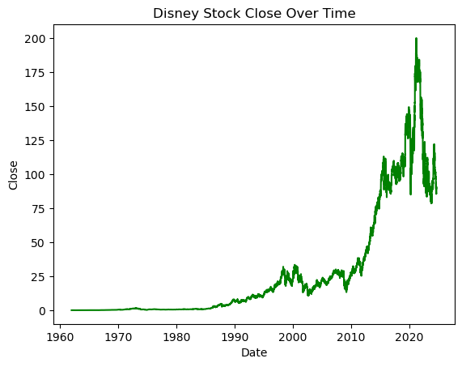
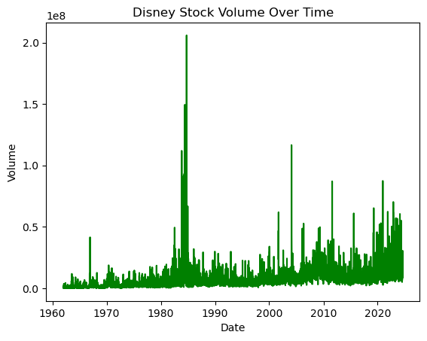
Line Chart EDA

Slide 6
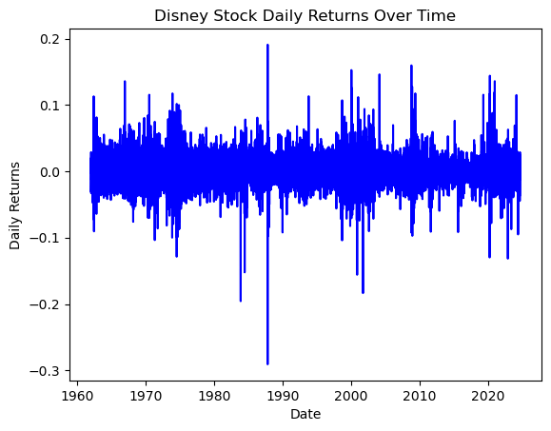
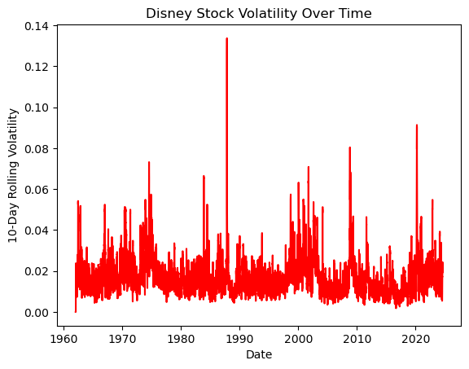
Line Chart EDA

Slide 7
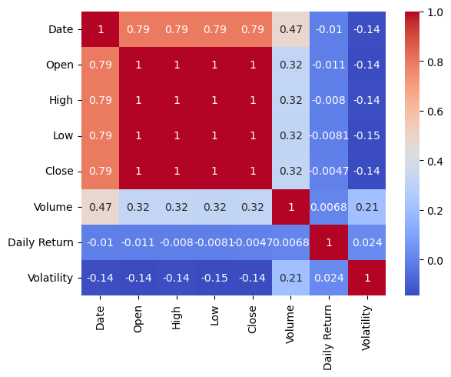
Correlation EDA

Slide 8
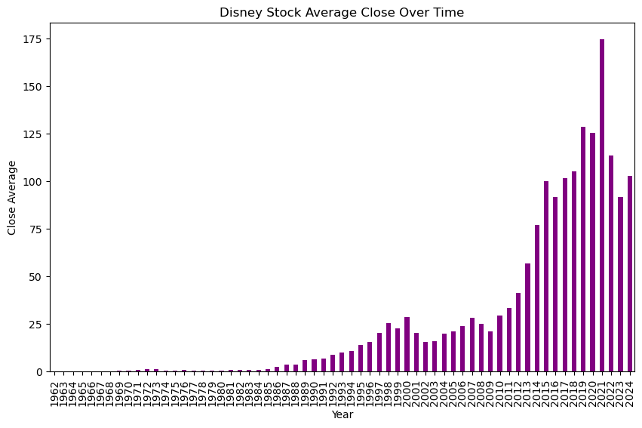
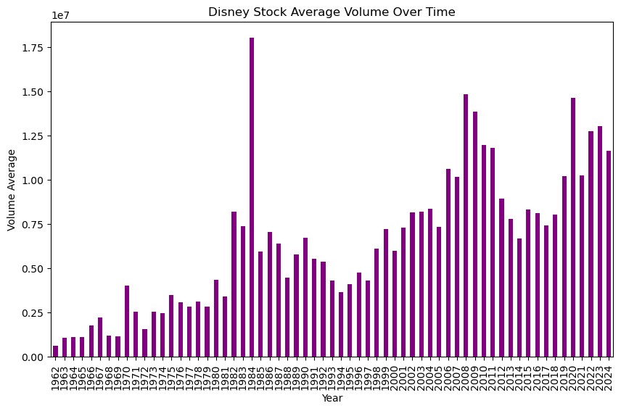
Bar Chart EDA

Slide 9
Data Preparation
The Datetime data type was asserted to work with time series data properly
Features were engineered, with many new variables mathematically stemming from the original ones
The data was subset to include only the most recent ten years’ worth of stock price data

Slide 10
Modeling
Model 1: ARIMA Time Series Model (Augment Dickey-Fuller Test to identify stationarity)
Model 2: Random Forest Regressor Model (add more features)

Slide 11
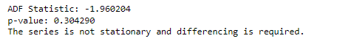
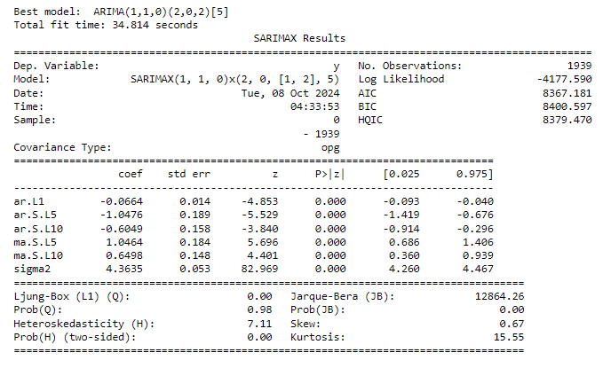
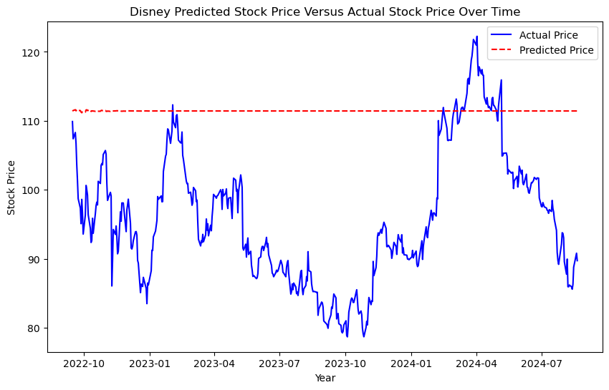
From ARIMA to SARIMA

Slide 12
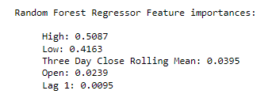
Results
Model | RMSE | R²
SARIMA Model | 18.241 | -2.663
Random Forest Regressor | 1.240 | 0.983

Slide 13
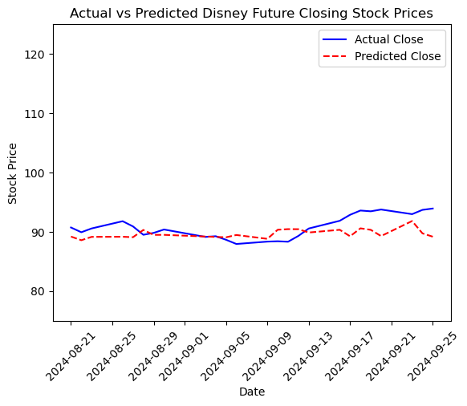
Deployment Test: Future Predictions?
After finding actual future values, the model was tested by generating predictions using unseen data.
The regressor’s RMSE was 2.25, showcasing high-level accuracy for the Walt Disney Company’s future stock price predictions.

Slide 14
Future Recommendations
If current or potential Disney shareholders want to take action, here is what the data shows to elicit careful thoughts to alleviate unnecessary financial risk:
Buy: Current and future predictions look promising along with underlying trends and patterns, yet further evaluation is required to take external forces into account
Hold: Consider placing stop-limit orders and playing the long game
Sell: Determine if the current ROI is satisfactory before relinquishing shareholder privileges

Slide 15
Conclusions
The SARIMA model performed poorly while the random forest regressor has proven its ability to be deployed
The viable model’s results can be used to prompt data-driven decisions for shareholders of Disney stock, no matter if they wish to buy, hold, or sell
With the Walt Disney Company’s performance looking promising as the data shows, shareholders can expect this research to benefit all parties involved

Slide 16
Sources
Tenebruso, J. (2020, November 2). If You Invested $1,000 in Disney's IPO, This is How Much Money You'd Have Now. Nasdaq. Retrieved October 4, 2024, from https://www.nasdaq.com/articles/if-you-invested-$1000-in-disneys-ipo-this-is-how-much-money-youd-have-now-2020-11-22
Patel, K. (2024, August 20). Disney Stock Data. Retrieved October 4, 2024, from https://www.kaggle.com/datasets/krupalpatel07/disney-stock-data
Yahoo! (2024, October 4). The Walt Disney Company (DIS). Yahoo!Finance. Retrieved October 5, 2024, from https://finance.yahoo.com/quote/DIS/history/

